Slide 1
COEN-6312
MODEL DRIVEN SOFTWARE
ENGINEERING
(ONLINE BOOK STORE)
Submitted By:(Team Singh)
Guneet Singh-27364377
Rattan deep Singh-27670052
Satinder Pal Singh-27162375
Instructor :
Abdelwahab Hamou LhaDj

Slide 2
Agenda
Introduction
Purpose
Use Case Diagram and Description
Class Diagram
OCL Constraints
State Diagram
ASL Language
Code Generation through Papyrus
Class diagram after Implementation
Tools
Collaboration Tools
Challenges & Lessons Learnt
Conclusion

Slide 3
Introduction
An “Online Book Store” system is a commercial enterprise system.
The main objective of the project is to design an online bookstore system, which enables the customers to search and buy a book online.
A customer can go on the website and search for the desired book.
Once the Customer finds the desired book, They can add the book to cart, View the Cart .

Slide 4
Purpose of Project
Makes life easy.
Customer does not have to physically go to a book store he/she can search for the book online.
The focus of our project is to give more facilities with fewer complexities to the readers of Canada who are passionate for reading.
Ease of availability of Books.

Slide 5
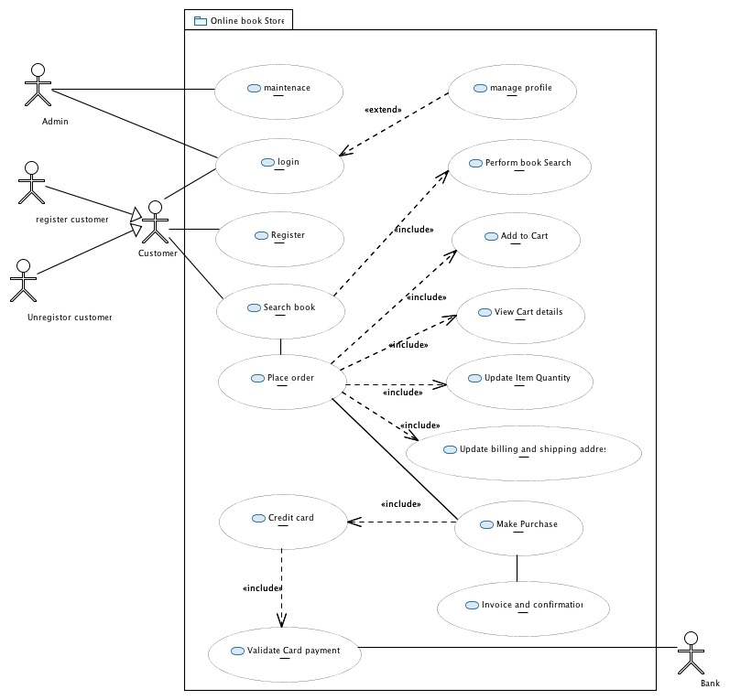
Use Case Diagram Of online Book Store

Slide 6
Use Case Descriptions
Name Search Books
Short Description | Customer looks for the required book.
Precondition | Customer has login into system (optional).
Post-condition | Customer finds or does not find the searched book.
Error Situation | Customer misspells the book/author name.
System state in the event of an error | Displays unavailability of the book to the customer and show some suggestions.
Actors | Customer
Trigger | Customer Intends to search the required book.
Standard Process | (1) Customer searches for a particular book. (2) Checks availability of the searched book. (3) Displays information of the book.
Alternative Process | No alternative process available.
Use Case Description Of Search book.

Slide 7
Use Case Descriptions
Name Place order
Short Description | Customer chooses the book; he/she wish to buy.
Precondition | Customer has logged into Online Book store and searched for the book.
Post-condition | Books selected and added to shopping cart.
Error Situation | The requested book is unavailable now It is better to say “at the time of access”.
System state in the event of an error | The customer cannot select the book.
Actors | Registered customer
Trigger | Customer clicks the “Add to cart” button.
Standard Process | (1) The customer logins into the system. (2) The customer searches for the book. (3) The customer selects the book.
Use Case Description Of Place Order.

Slide 8
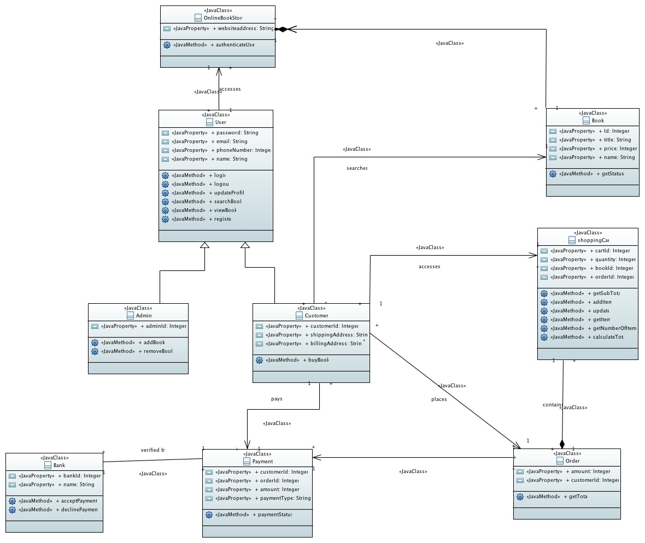
Class Diagram

Slide 9
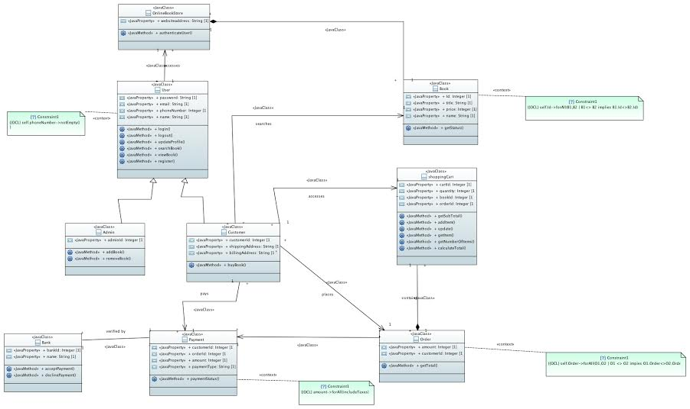
Class Diagram With OCL Constraints

Slide 10
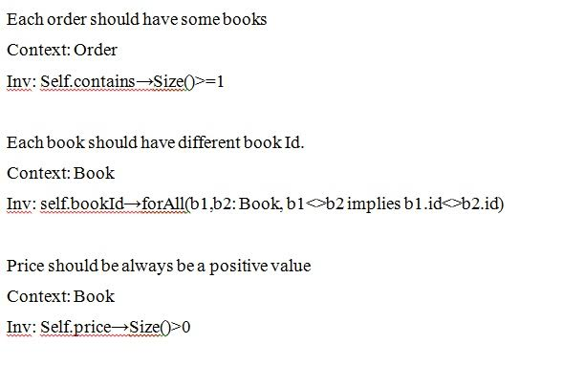
OCL Constraints

Slide 11
OCL Constraints

Slide 12
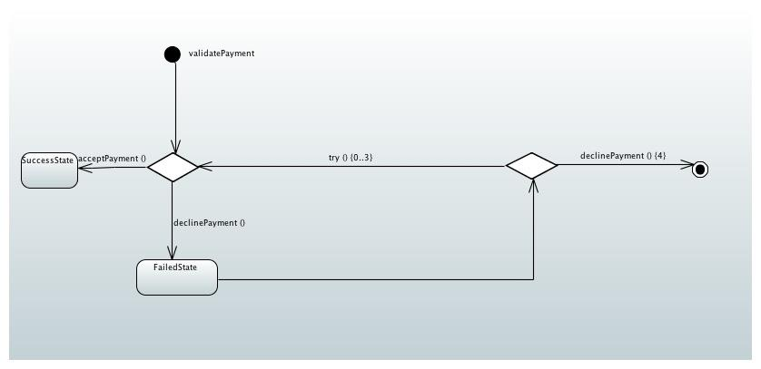
State Diagram Of Bank

Slide 13
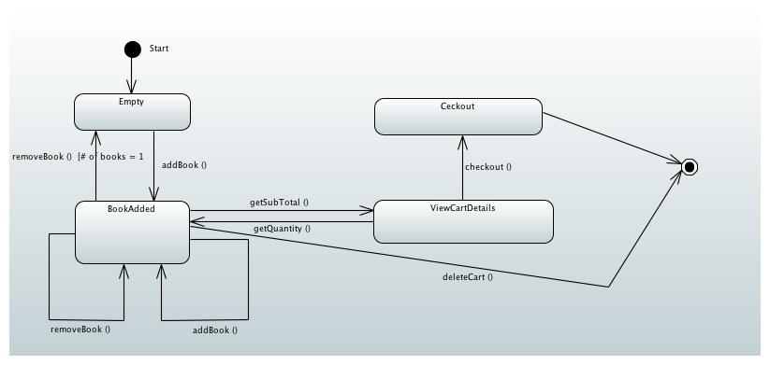
State Diagram Of Shopping cart

Slide 14
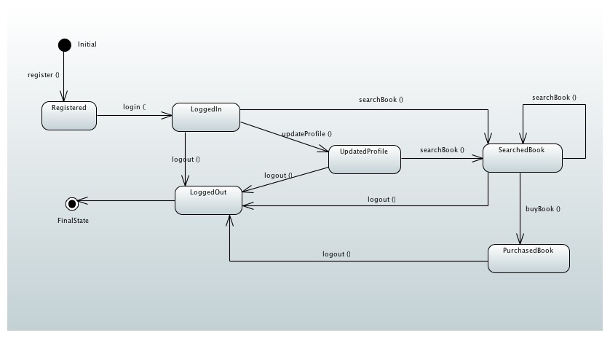
State Diagram Of Customer

Slide 15
ASL for Bank State Machine Diagram
:validatePayment(amount,payment_status, card_number, card_holder_name) If this.validateCard (card_number, card_holder_name) == true and this.sufficientAmount == true Then this.payment_status = This.acceptPayment() Alert(payment_status) endif;
:declinePayment() If this.sufficientAmount(amount)==false Then If this.try() <= 3; this.validateCard (card_number, card_holder_name) == true and this.sufficientAmount == true Then this.payment_status = This.acceptPayment() Alert(payment_status) Else declinePaymentConfirmation Alert(declinePayment) endif;

Slide 16
ASL for Customer State Machine Diagram
:register(String customer_name, int password,String first_name,String last_name) If this. customer_name!=null and this.password!=null and this. first_name!=null and this. last_name!=null Then This.customerSaved = This.saveCustomer () Alert(customerSaved); endif;
:searchBook(String book_id, book_title, book_author, book_edition) book_id!=null and book_title=null and book_author=null and book_edition!=null
Then This.ViewBookInformation = This.BookInformationViewed() Alert(ViewBookInformation); endif;

Slide 17
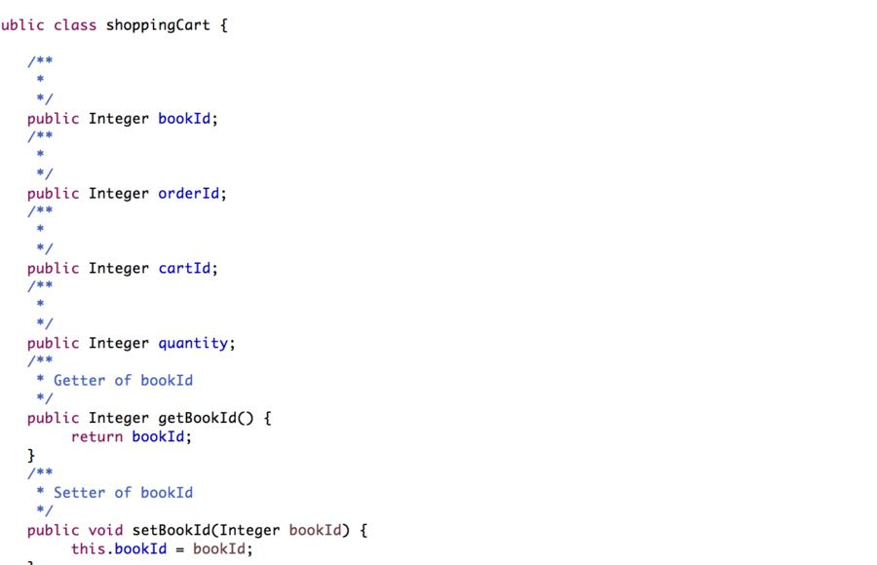
Code generation through Papyrus

Slide 18
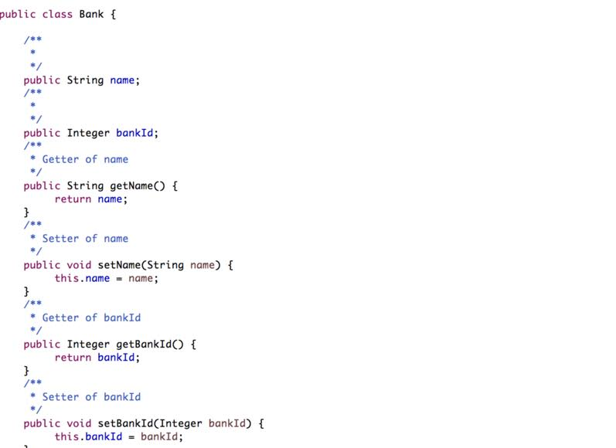
Code generation Papyrus(Contd.)

Slide 19
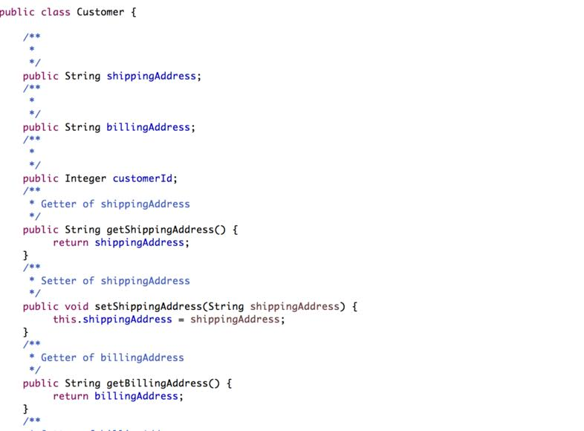
Code generation Papyrus(Contd.)

Slide 20


Slide 21
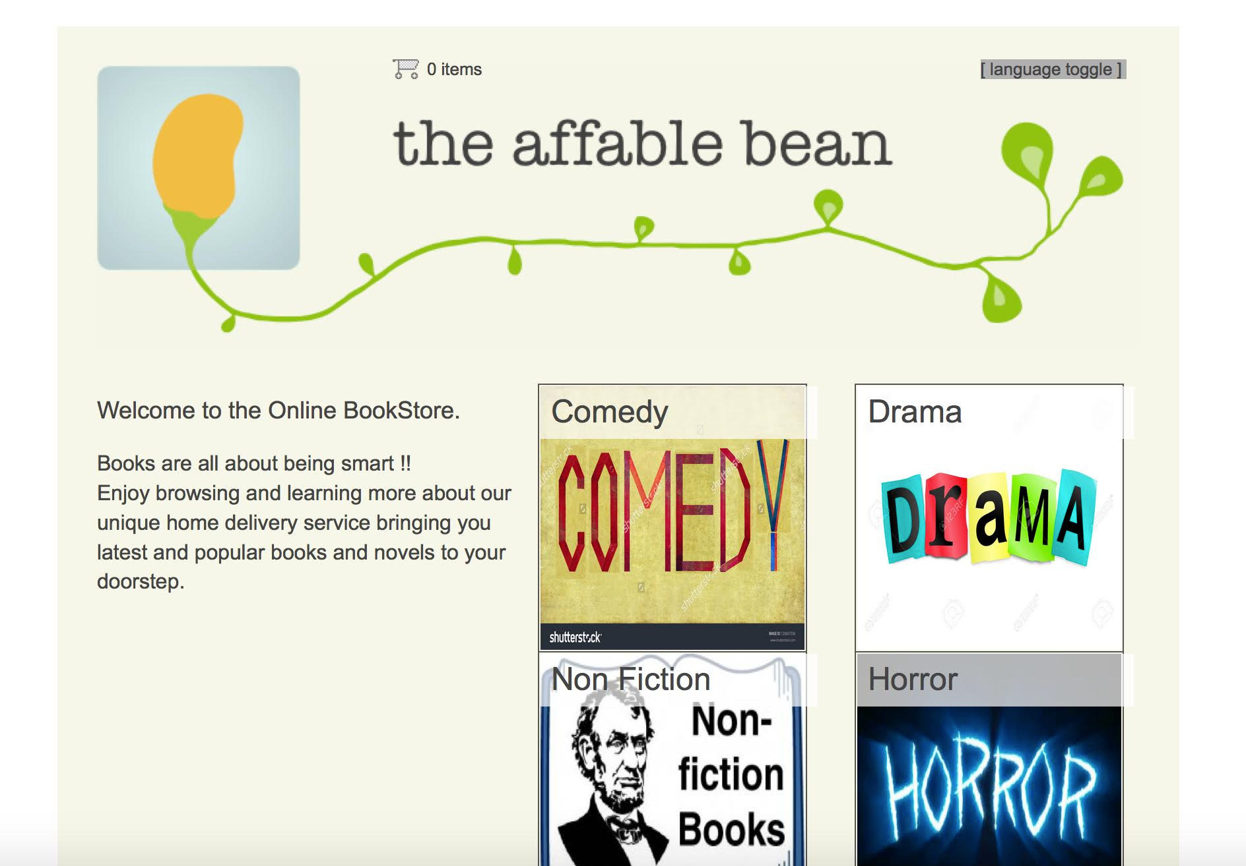
Home Page

Slide 22
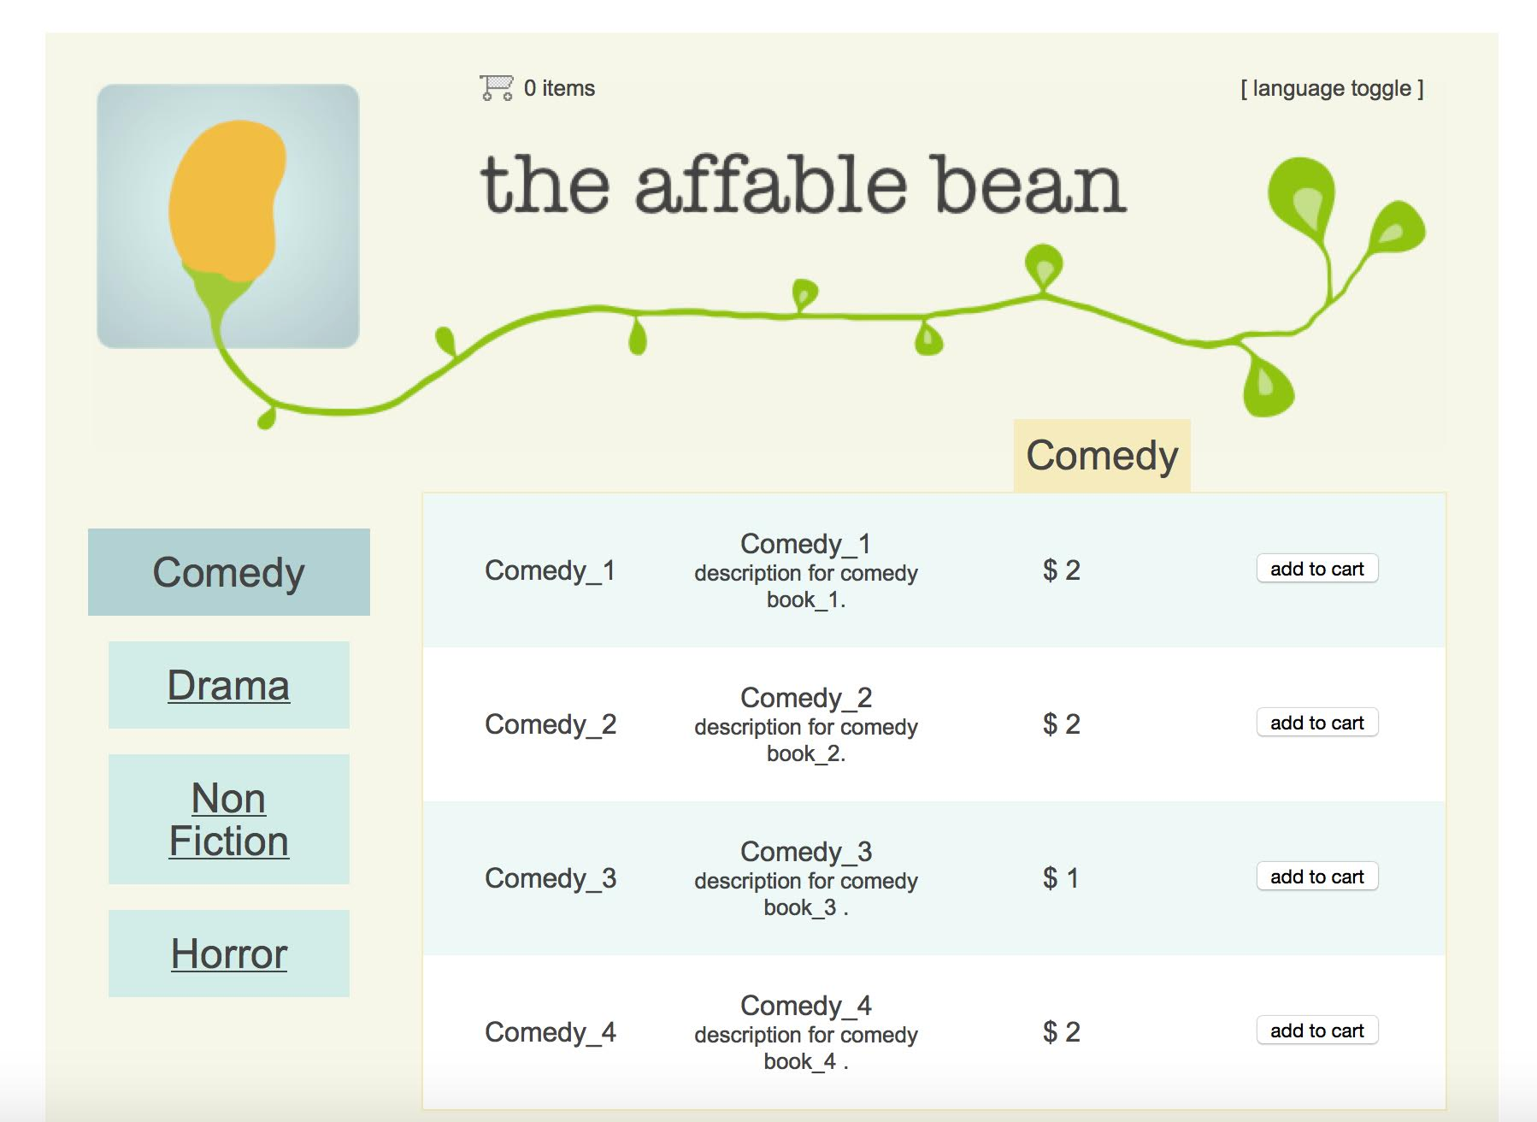
Displaying Different Book

Slide 23
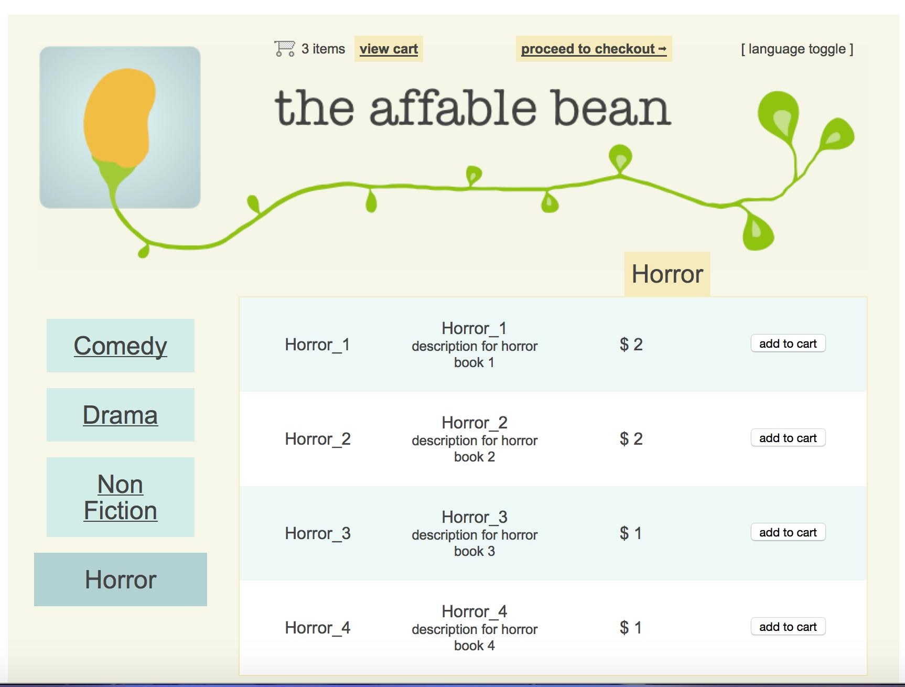
Add To Cart

Slide 24
View Cart

Slide 25
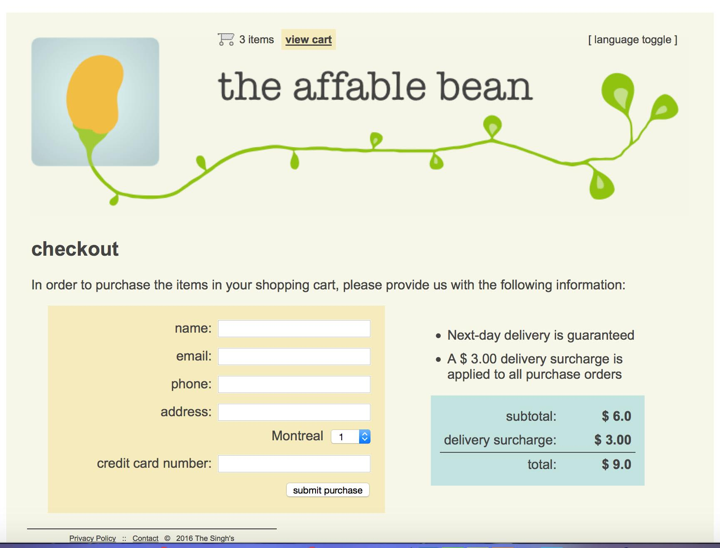
Checkout

Slide 26
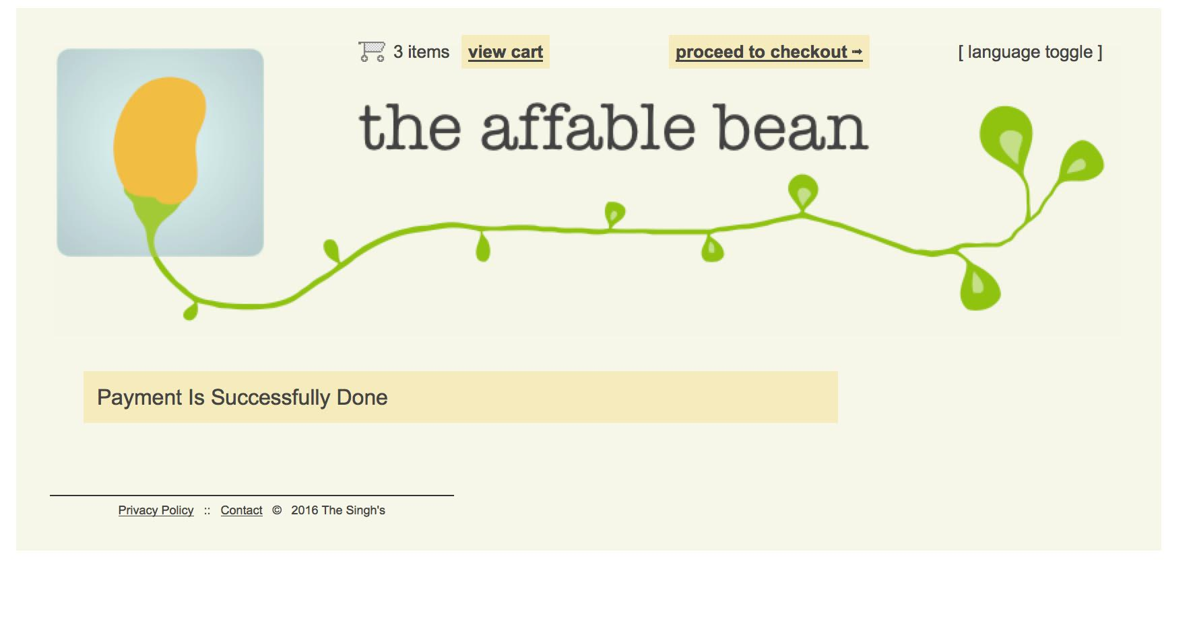
Payment page

Slide 27
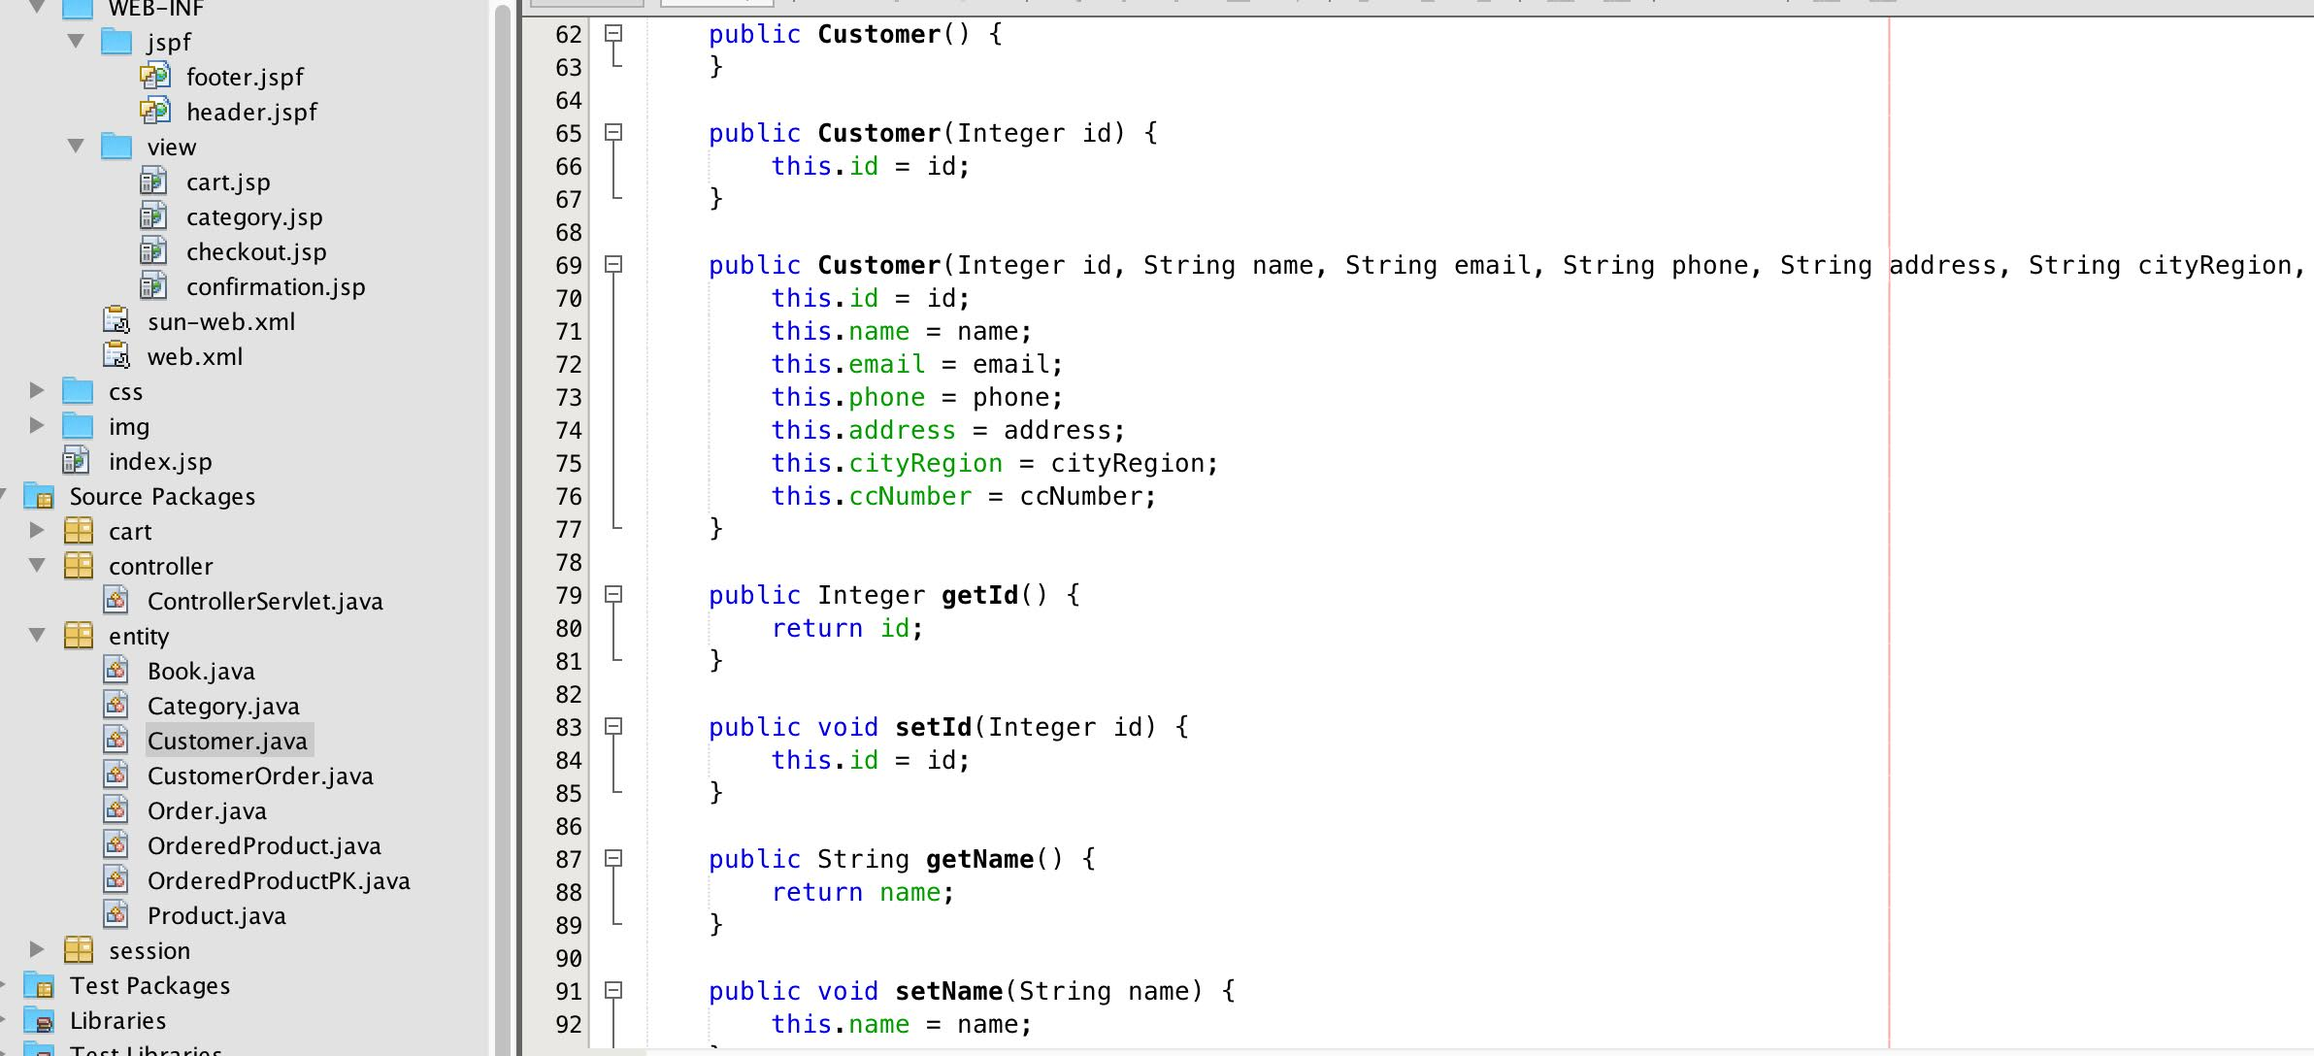
Customer Class After Implementation

Slide 28
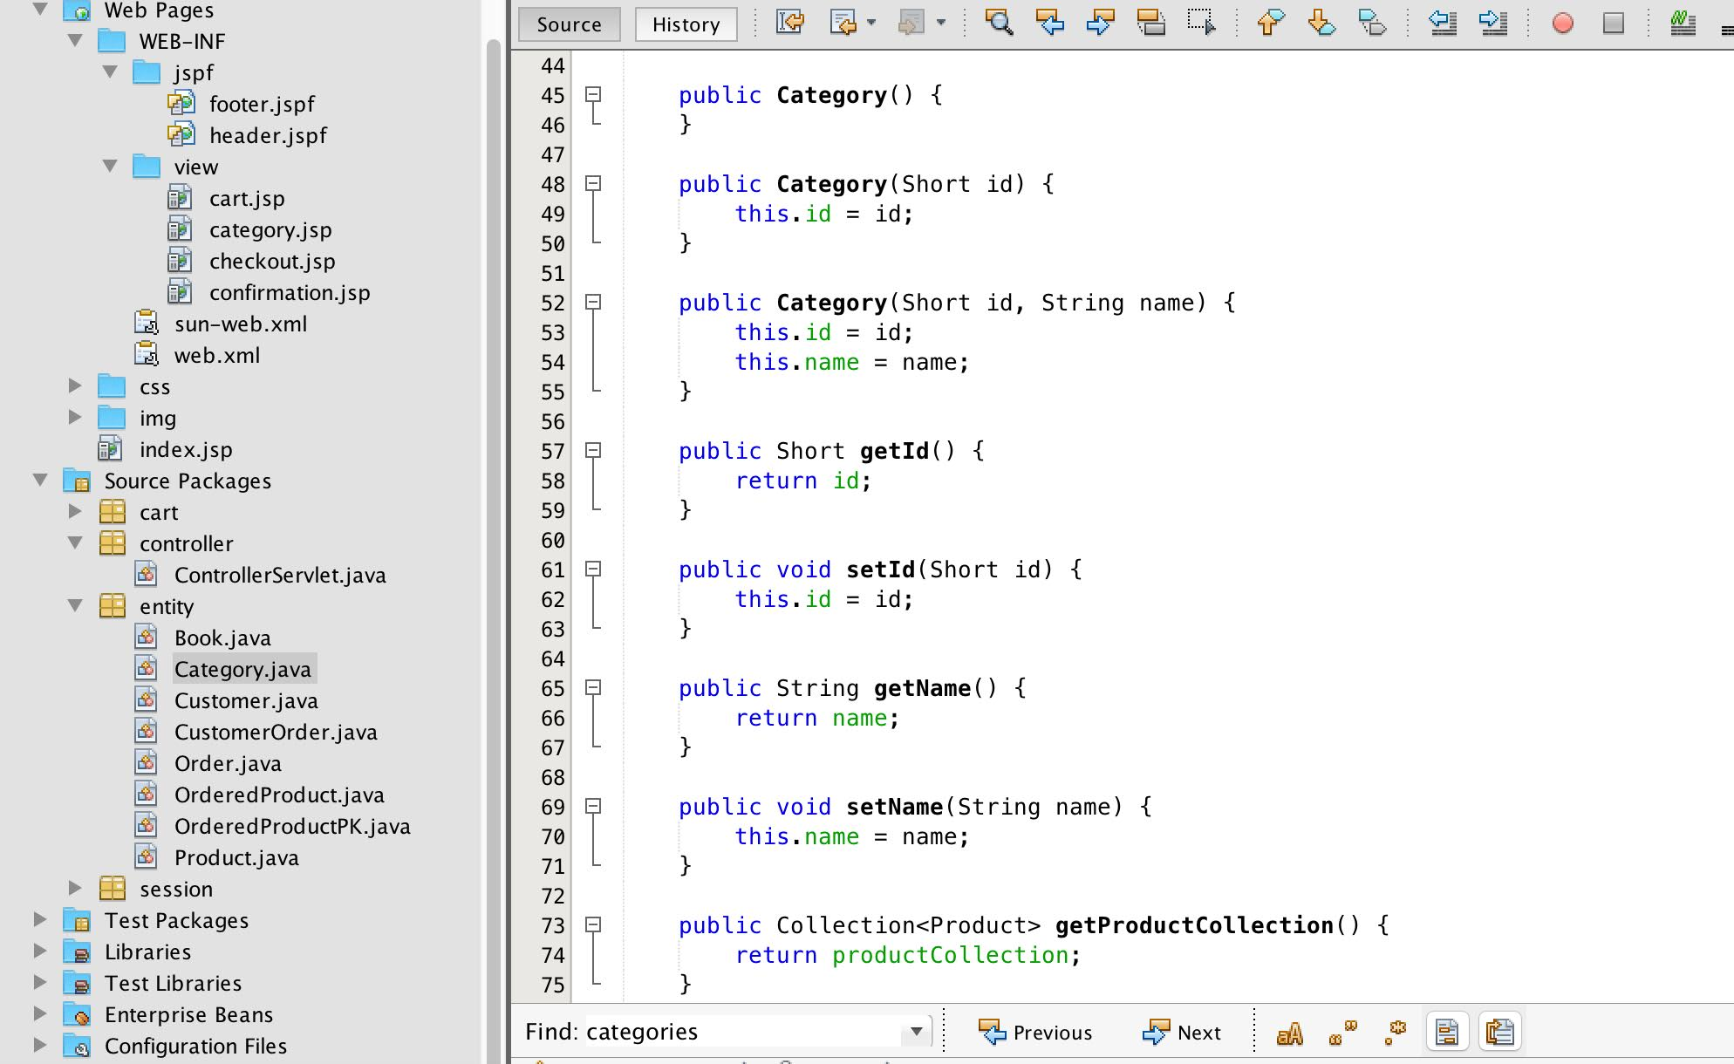
Category Class After Implementation

Slide 29
Tool Used
Eclipse IDE
Papyrus
Netbeans IDE
MySql Workbench
GitHub

Slide 30
GitHub
GitHub is a code sharing and publishing services.
GitHub has a central repository of all files associated with the project
Focus on the Requester or the customer needs.
Easy to use, Secure, reliable.

Slide 31


Other Collaboration Tools.
Google Drive— To edit the documents and shared our extra work.
WhatsApp— For Communication and to arrange project meetings
Email— Exchange of Documents

Slide 32
Lesson Learnt and challenges
Team work and collaboration.
Hands on experience with different modeling tools.
Setting Up of tools
Code Generation of OCL
Generating code after implementing Class diagram.

Slide 33
Conclusion
We were able to generate java code through class diagram and were able to use a part of that code in our application.
At the end we can conclude that we gain knowledge about Use case diagram, Class diagram,ocl Language,state diagrams.

Slide 34
Future work
Implementing login pages for admin and customer.
Implementing more Book categories (or Genre).
Implementing the language toggle in our web page.
Implementing Code through OCL

Slide 35
THANK YOU

